Slide 1
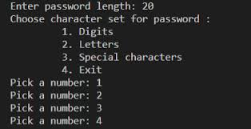
Generate any Password
K’Vaughn Crittenden
Users can receive a password containing a random assortment of letters, numbers, and special characters.

